Slide 1
SimplIFIED
Distributed database
Exploring the Hybrid Logical Clock
By Muzhou Liu
For CS6650, SP2024

Slide 2

ABOUT
01
Want to explore more on a distributed database and trying to implement a simplified version to better understand the whole process

Slide 3
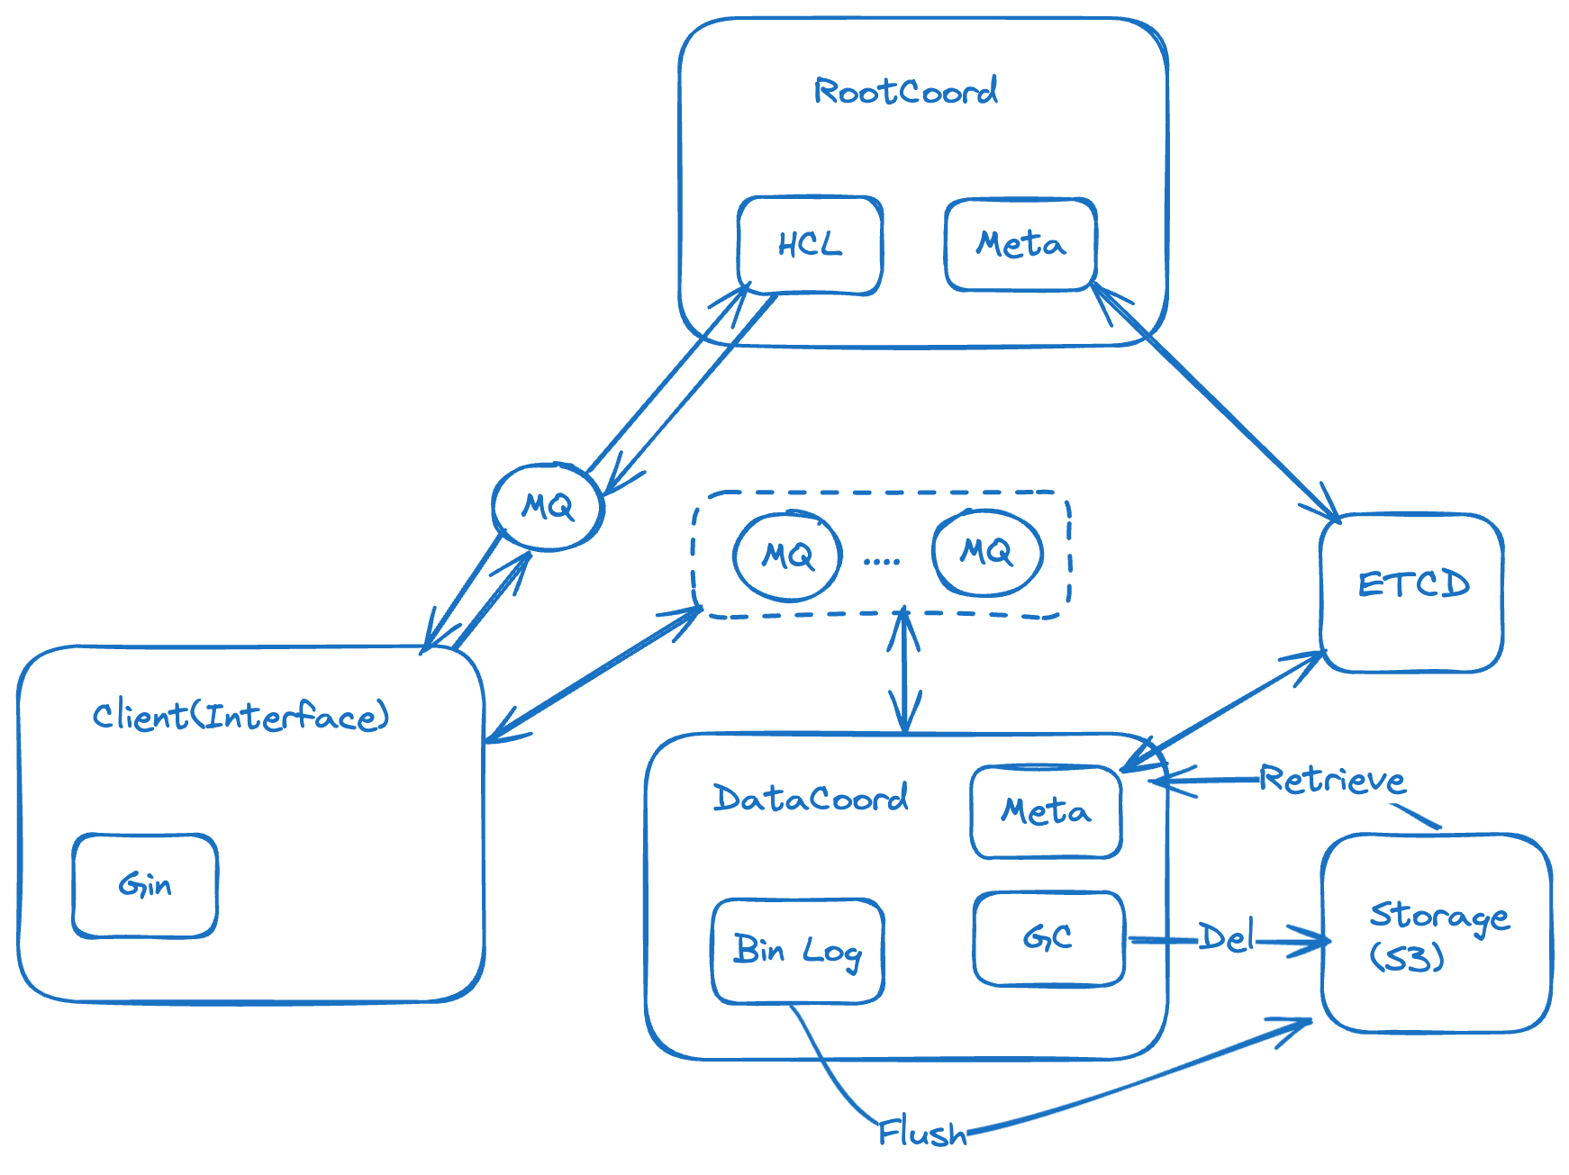
Design

Slide 4
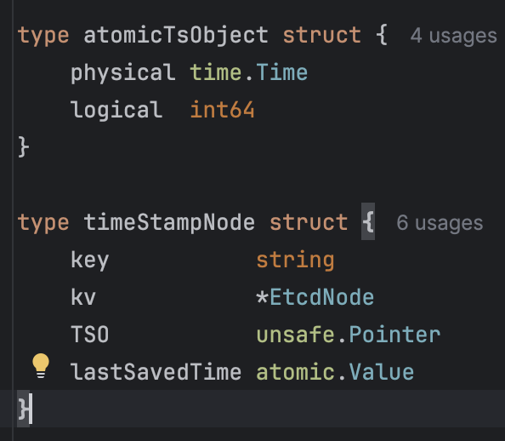
Time Stamp
For each message that the client creates, it apply for a timestamp from the Root Coordinator and put it into MQ message body for Data Coordinator.
…
Query Ts
…
Service Ts
…
Query Ts
Service Ts
For Query task, we add a service Ts to ensure we are getting the latest Info of the stored data. Service Ts is periodically (50ms) update to meta data and Query will wait for the closest Service Ts to return the result.

Slide 5
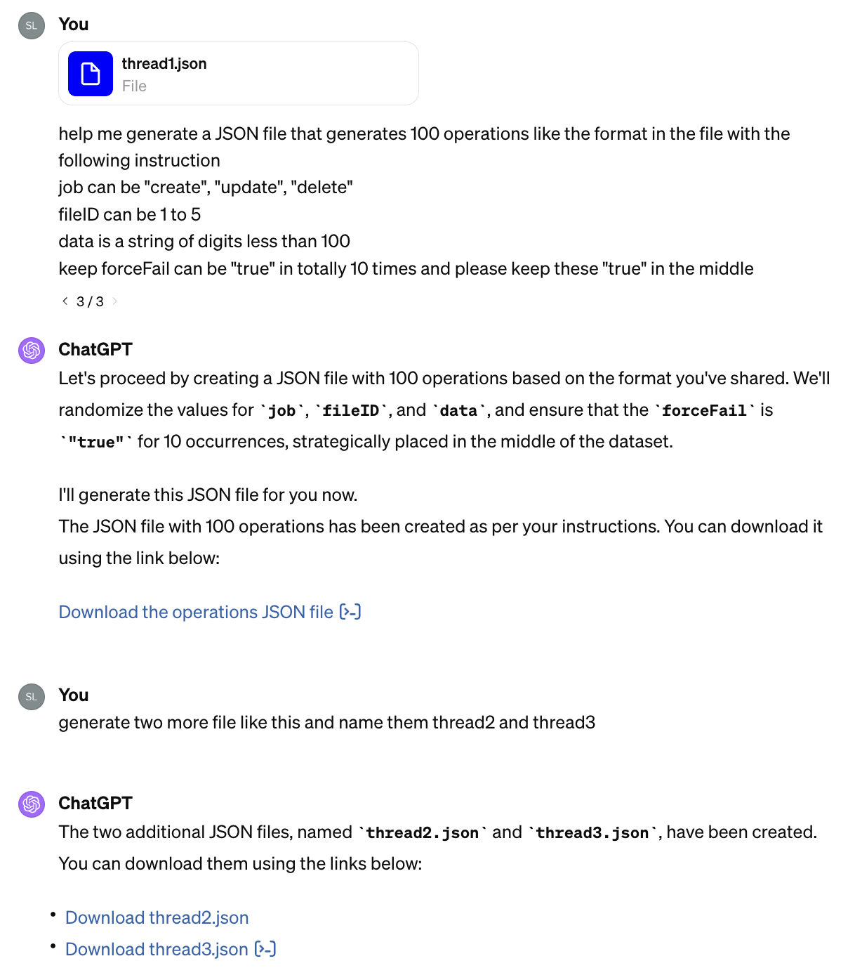
Evaluation
Generated a Sequence of operation and added some forced fail in operation. In the end, check the log, compare the Metadata and stored Json file on S3 to check correctness

Slide 6
FuTure works
Implement the WAL (write ahead log) for 2 purpose
Better verify the correctness of the system
Help restore the system from disruption

Slide 7
Thanks
https://github.khoury.northeastern.edu/mzhl1111/Simple-Distributed-DB-HCL
https://github.com/milvus-io/milvus

